Slide 1
Supervised Learning: A Comprehensive Guide
By,
Name : Vishal Kumar Paswan
Roll Number : 24MA10068

Slide 2
Introduction to Machine Learning
Machine learning is the process through which a system, which operates on “Artificial Intelligience”, can train itself (without explicit instructions) through accessing provided data.
A machine can be taught to interpret data in two methods :
1. Supervised learning, and
2. Unsupervised learning.

Slide 3
What is Supervised Learning?
Supervised learning is the method for an artificial intelligence to access data from the given dataset and then provide definitive labels as their output.
They do this by recognizing patterns and trends in “training data”, by factoring in each feature mentioned in their dataset. Then, they are given a “test data”, where they can measure their accuracy rates and then learn from those results.

Slide 4
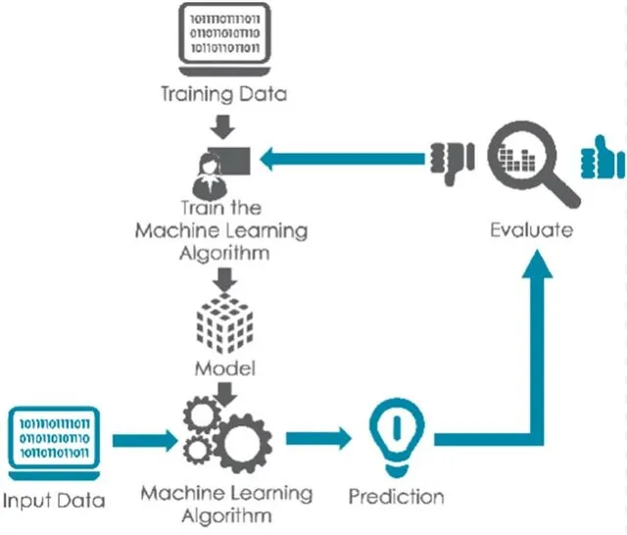
Source :
Supervised learning: a comprehensive guide (by KodeInKGP)

Slide 5
Methods in Supervised learning
Data in supervised learning can be interpreted by the machine learning algorithm in two ways :
Classification : Here, the algorithm provides distinction between two or more types of data into categories.
Regression : Here, the algorithm predicts a concrete, numerical value for the features provided to it.

Slide 6
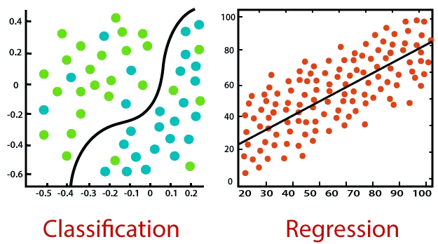
Source : Supervised learning: a comprehensive guide (by KodeInKGP)

Slide 7
More about the classification model
Since the classification model deals with distribution of models based on their features, it requires some knowledge of logistic regression (where we provide concrete values to probabilistic values and segregate depending on their values), gradient boosting, etc.
This is especially useful in healthcare sectors, where patients can be diagnosed for a disease depending on their health conditions. This is also useful in other fields involving classifying large amounts of data and segregating them so as to ease operations on them.

Slide 8
More about the regression model
Since the regression model deals in determining the “line of best fit” in graphs (so as to find the optimal value for given parameters), it is especially important to have knowledge of graphs, statistics and probabilistic distribution of values.
This is especially useful in areas where we have to predict the value of a certain commodity based on the parameters given, such as stocks and house pricings.

Slide 9
Real World Applications of Supervised Learning
1. Stock Market Predictors
2. Medical Diagnosers
3. Image and Speech Recognition
4. Spam E-Mail Detector
5. Handwritten Digit Detector

Slide 10
Conclusion
To conclude, supervised learning enables the machine to efficiently interpret data and either classifies or predicts (in the near future) given data, which can be benefitting for the better for us.
But, it is necessary to produce optimal methods to store, provide and interpret data in lesser time with higher efficiency.

Slide 11
Thank You!

